Slide 1
Interactive Data Exploration with Smart Drill-Down
Manas Joglekar
Hector Garcia-Molina
Aditya Parameswaran

Slide 2
---Points---
What problem? Why important(?)
Like poster, start with picture of file. Explain we want to get value out of it.
Rules, interestingness, flexible, interactive
Weight and Score
Formal problem
Soln sketch
Examples

Slide 3
Definitions
Rule:
Subrule
Weight
Score

Slide 4
Formal Problem
Problem 1: Given a table T , a monotonic weighting function W, and a number k, find the list R of k rules that maximizes
for one of the following smart drill down operations: • [Rule drill down]
• [Star drill down]

Slide 5
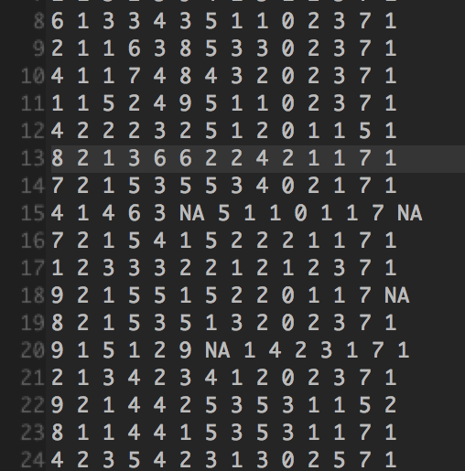

Slide 6
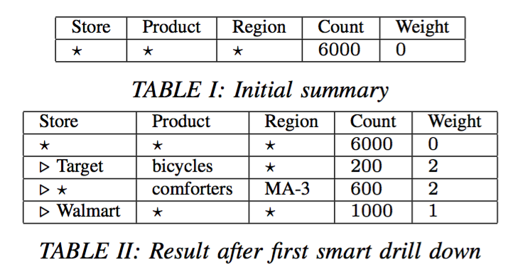

Slide 8
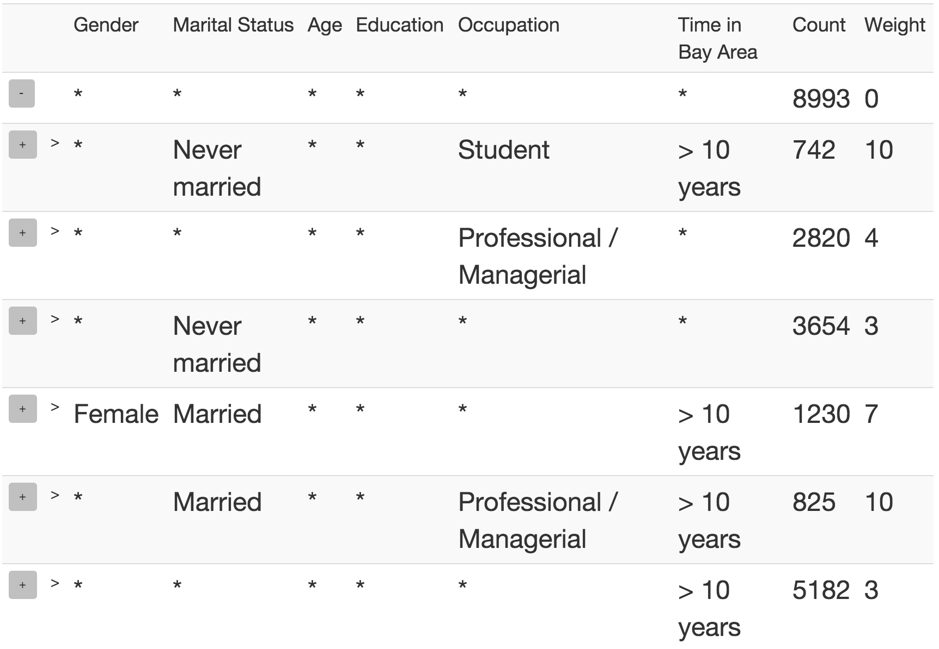

Slide 9
High level Algorithm

Slide 10
Finding the best rule

Slide 11
Scaling to large datasets
Sampling
Predict clicks and maintain samples
NP-Hard
DP approximation

Slide 12
System Architecture

Slide 13
Experiments
Datasets
Marketing Survey
Census
Studies
Qualitative
Quantitative

Slide 14
Size weighting

Slide 15
Bits weighting

Slide 16
Running time vs. mw

Slide 17
Running time vs. minSS

Slide 18
Count error vs. minSS

Slide 19
Rule error vs. minSS

